Slide 1

M S bidve engineering college, latur
Presented by : parth shankar murge
Roll no. : 40
Topic : firewire

Slide 2
FIREWIRE
IEEE 1394

Slide 3
Content
Introduction
History And Development
FireWire Specification
Goals Behind Creating Firewire
Firewire VS. USB
FireWire Cables & Connectors
FireWire’ Applications
Conclusion
FIREWIRE

Slide 4

iNTRODUCTION
The IEEE 1394 interface is a serial bus interface standard.
The interface is also known by the brand names of FireWire (Apple), i.LINK (Sony), and Lynx (Texas Instruments).
IEEE 1394 is the High-Definition Audio-Video Network Alliance (HANA) standard connection interface for A/V component communication and control.
FireWire inspired a new generation of consumer electronics devices from many companies, including Canon, Epson, HP, Maxtor, Mitsubishi, Matsushita (Panasonic), Pioneer, Samsung, Sony and Texas Instruments.

Slide 5
History and development
In the late 1980s Apple led the initiative for adoption of the IEEE standard 1394.
Apple intended Firewire to be a serial replacement for the parallel SCSI (Small computer system interface) bus.
Apple’s development of the original IEEE 1394 was completed in 1995.
IEEE

Slide 6
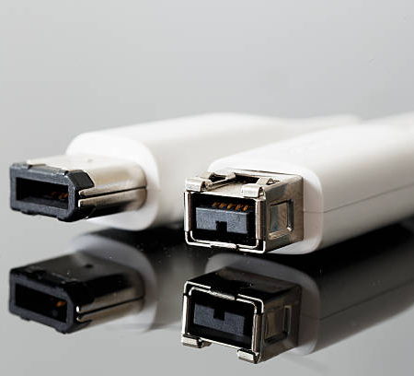
Firewire specifications
FireWire 400 features:
Transfer rates of up to 400 Mbps
Maximum distance between devices of 4.5 meters (cable length)
FireWire 800 is capable of:
Transfer rates up to 800 Mbps
Maximum distance between devices of 100 meters (cable length)
The faster 1394b standard is backward-compatible with 1394a.
FireWire 400 on left and
FireWire 800 on right

Slide 7
Particular goals behind creating firewire:
Fast transfer of data
Ability to put lots of devices on the bus
Ease of use
Hot-pluggable ability
Provision of power through the cable
Plug-and-play performance
Low cabling cost
Low implementation cost

Slide 8
Firewire vs. usb
Firewire
USB
FireWire 400 : 400 Megabits/s (Mbps)
FireWire 800 : 800 Mbps
FireWire 1600 : 1600 Mbps
FireWire 3200 : 3200 Mbps
USB 1.0 : 1.5 Megabits per second (Mbps)
USB 1.1 : 12 Mbps.
USB 2.0 : 480 Mbps.
USB 3.0 : 5 Gbps.
USB 3.1 : 10 Gbps
USB 3.2 : 20 Gbps
USB 4 : 40 Gbps

Slide 9
Firewire vs. usb
USB network use Star topology, while FireWire use Tree topology.
USB use a "speak-when-spoken-to" protocol. A FireWire device can communicate with any other node at any time.
A USB network relies on a single host. In a FireWire network, any capable node can control the network.
USB runs with a 5 V electricity, while Firewire can supply up to 30 V.
USB ports can provide up to 2.5 watts of power, while FireWire can supply up to 60 watts of power

Slide 10
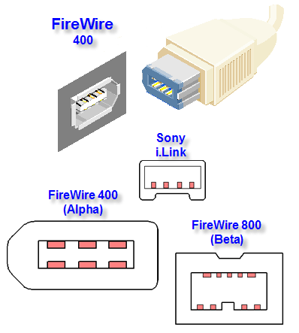
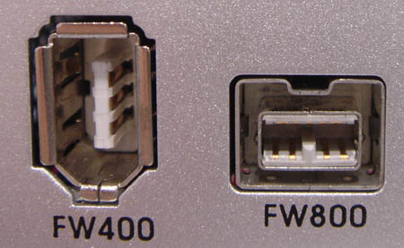
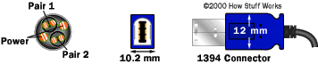
Firewire cables and connectors
FireWire devices can be powered or unpowered.
FireWire 400 uses 6- pin comfiguration.
i.LINK (Sony Co.) uses four pin connector.
FireWire 800 uses 9-pin configuration.
FireWire 800 : “bilingual” & “b-only”

Slide 11
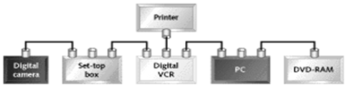
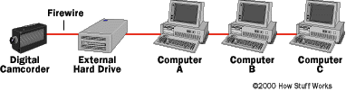
Because 1394 is a peer-to-peer protocol, a specific host isn’t required. In the above figure, the digital camera could easily stream data to both the digital VCR and the DVD-RAM without any assistance from other devices on the bus.
Data can be sent through up to 16 hops (device to device).

Slide 12
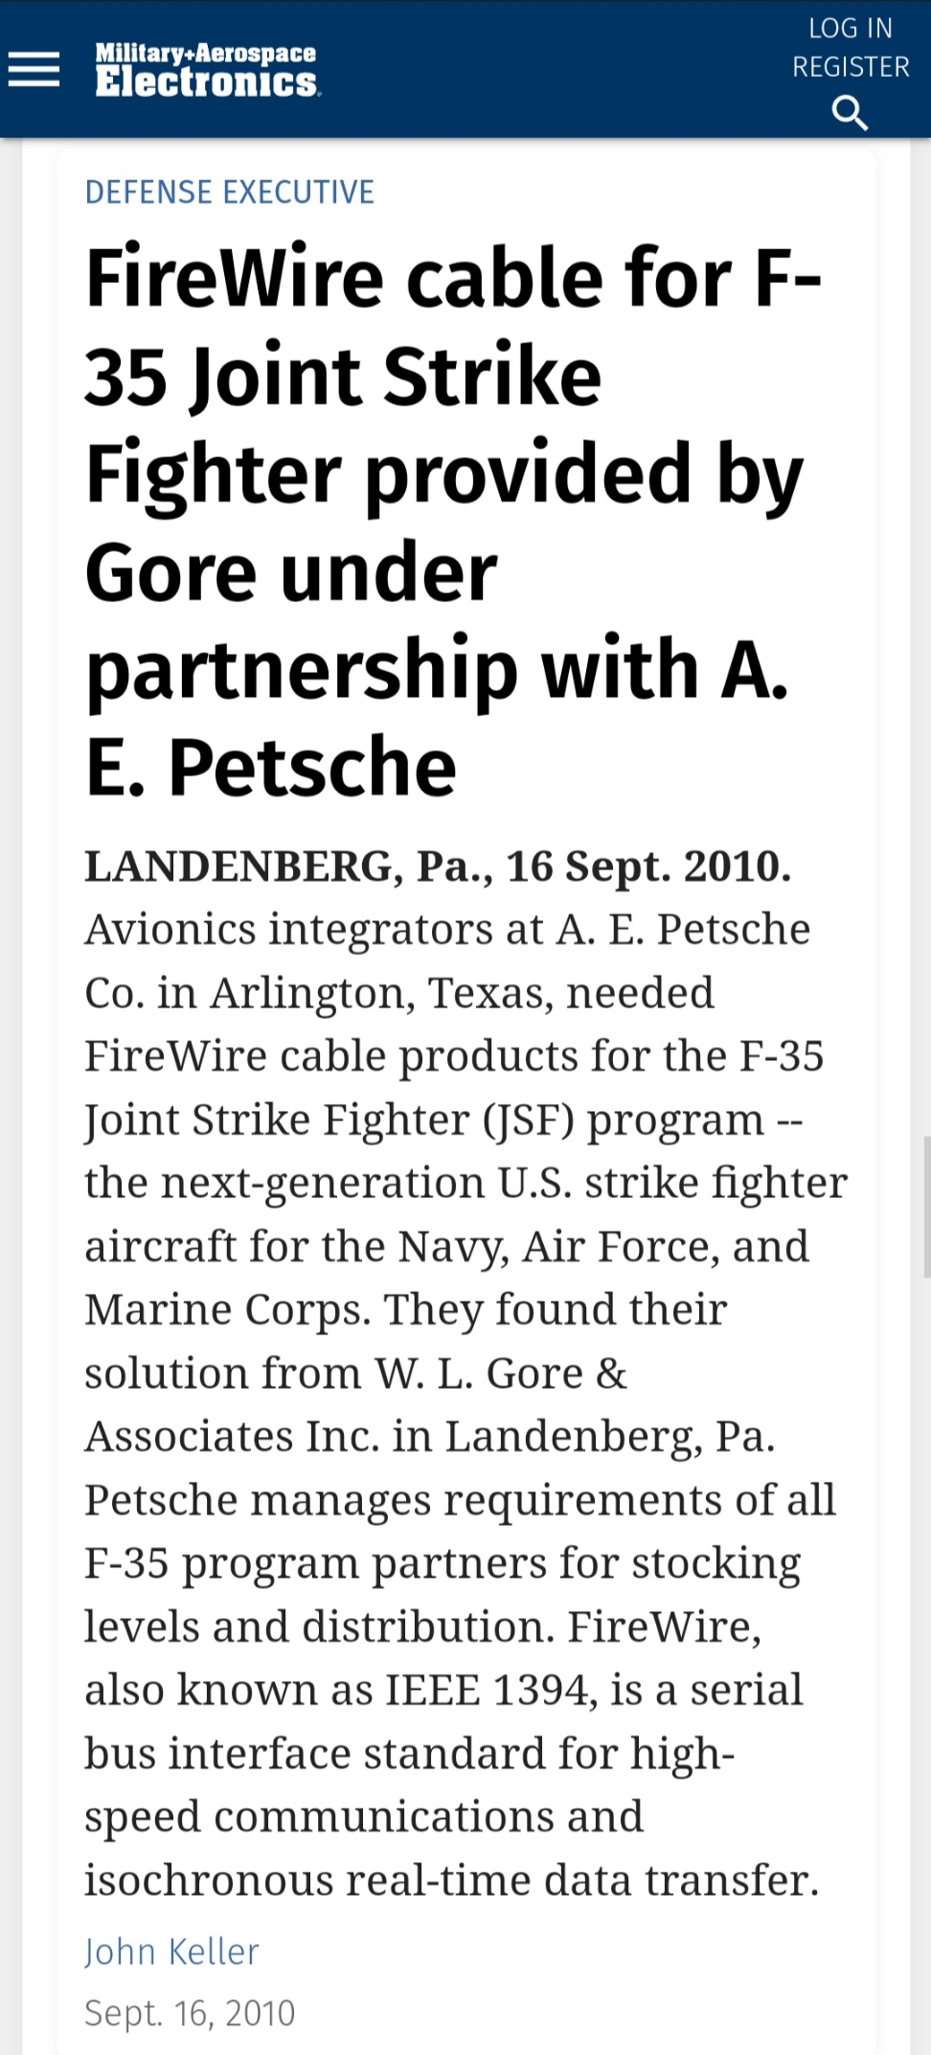
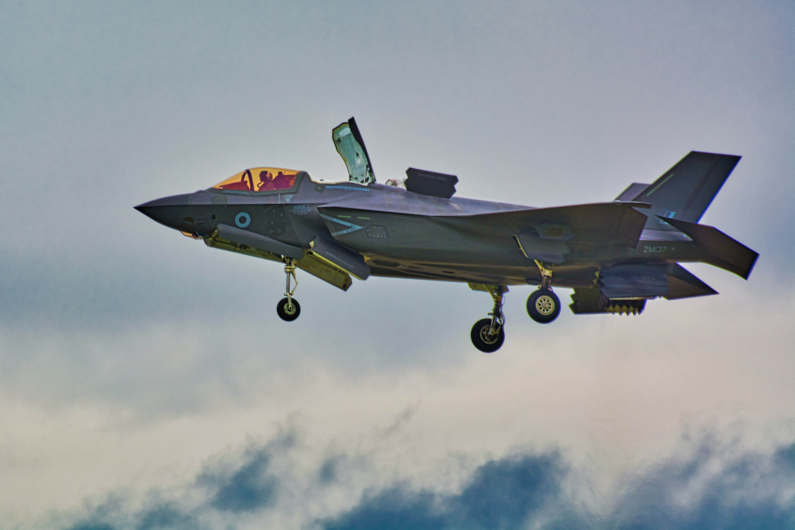
applications
It was used in different computer products.
It was commonly used to connect electronic appliances in automobiles.
In aerospace appliances, 1394 devices were used in US’ F-35 Joint Strike Fighter Aircraft.

Slide 13
conclusion
FireWire is one of the fastest peripherals ever developed, which makes it great for use with multimedia peripherals such as digital video cameras and other high speed devices like the latest hard disk drives and printers. It provides an inexpensive high speed method of interconnecting digital devices. Firewire 800 doubles the throughput of the original technology, dramatically increases the maximum distance of FireWire connections, and support many new types of cabling. FireWire was assumed to take upto a staggering rate of 3200Mbps from the theoretical 1600Mbps i.e. 3.2 Gbits/s that will make FireWire transfer massive data files and for even the most demanding applications, such as, working with uncompressed high definition video.

Slide 14
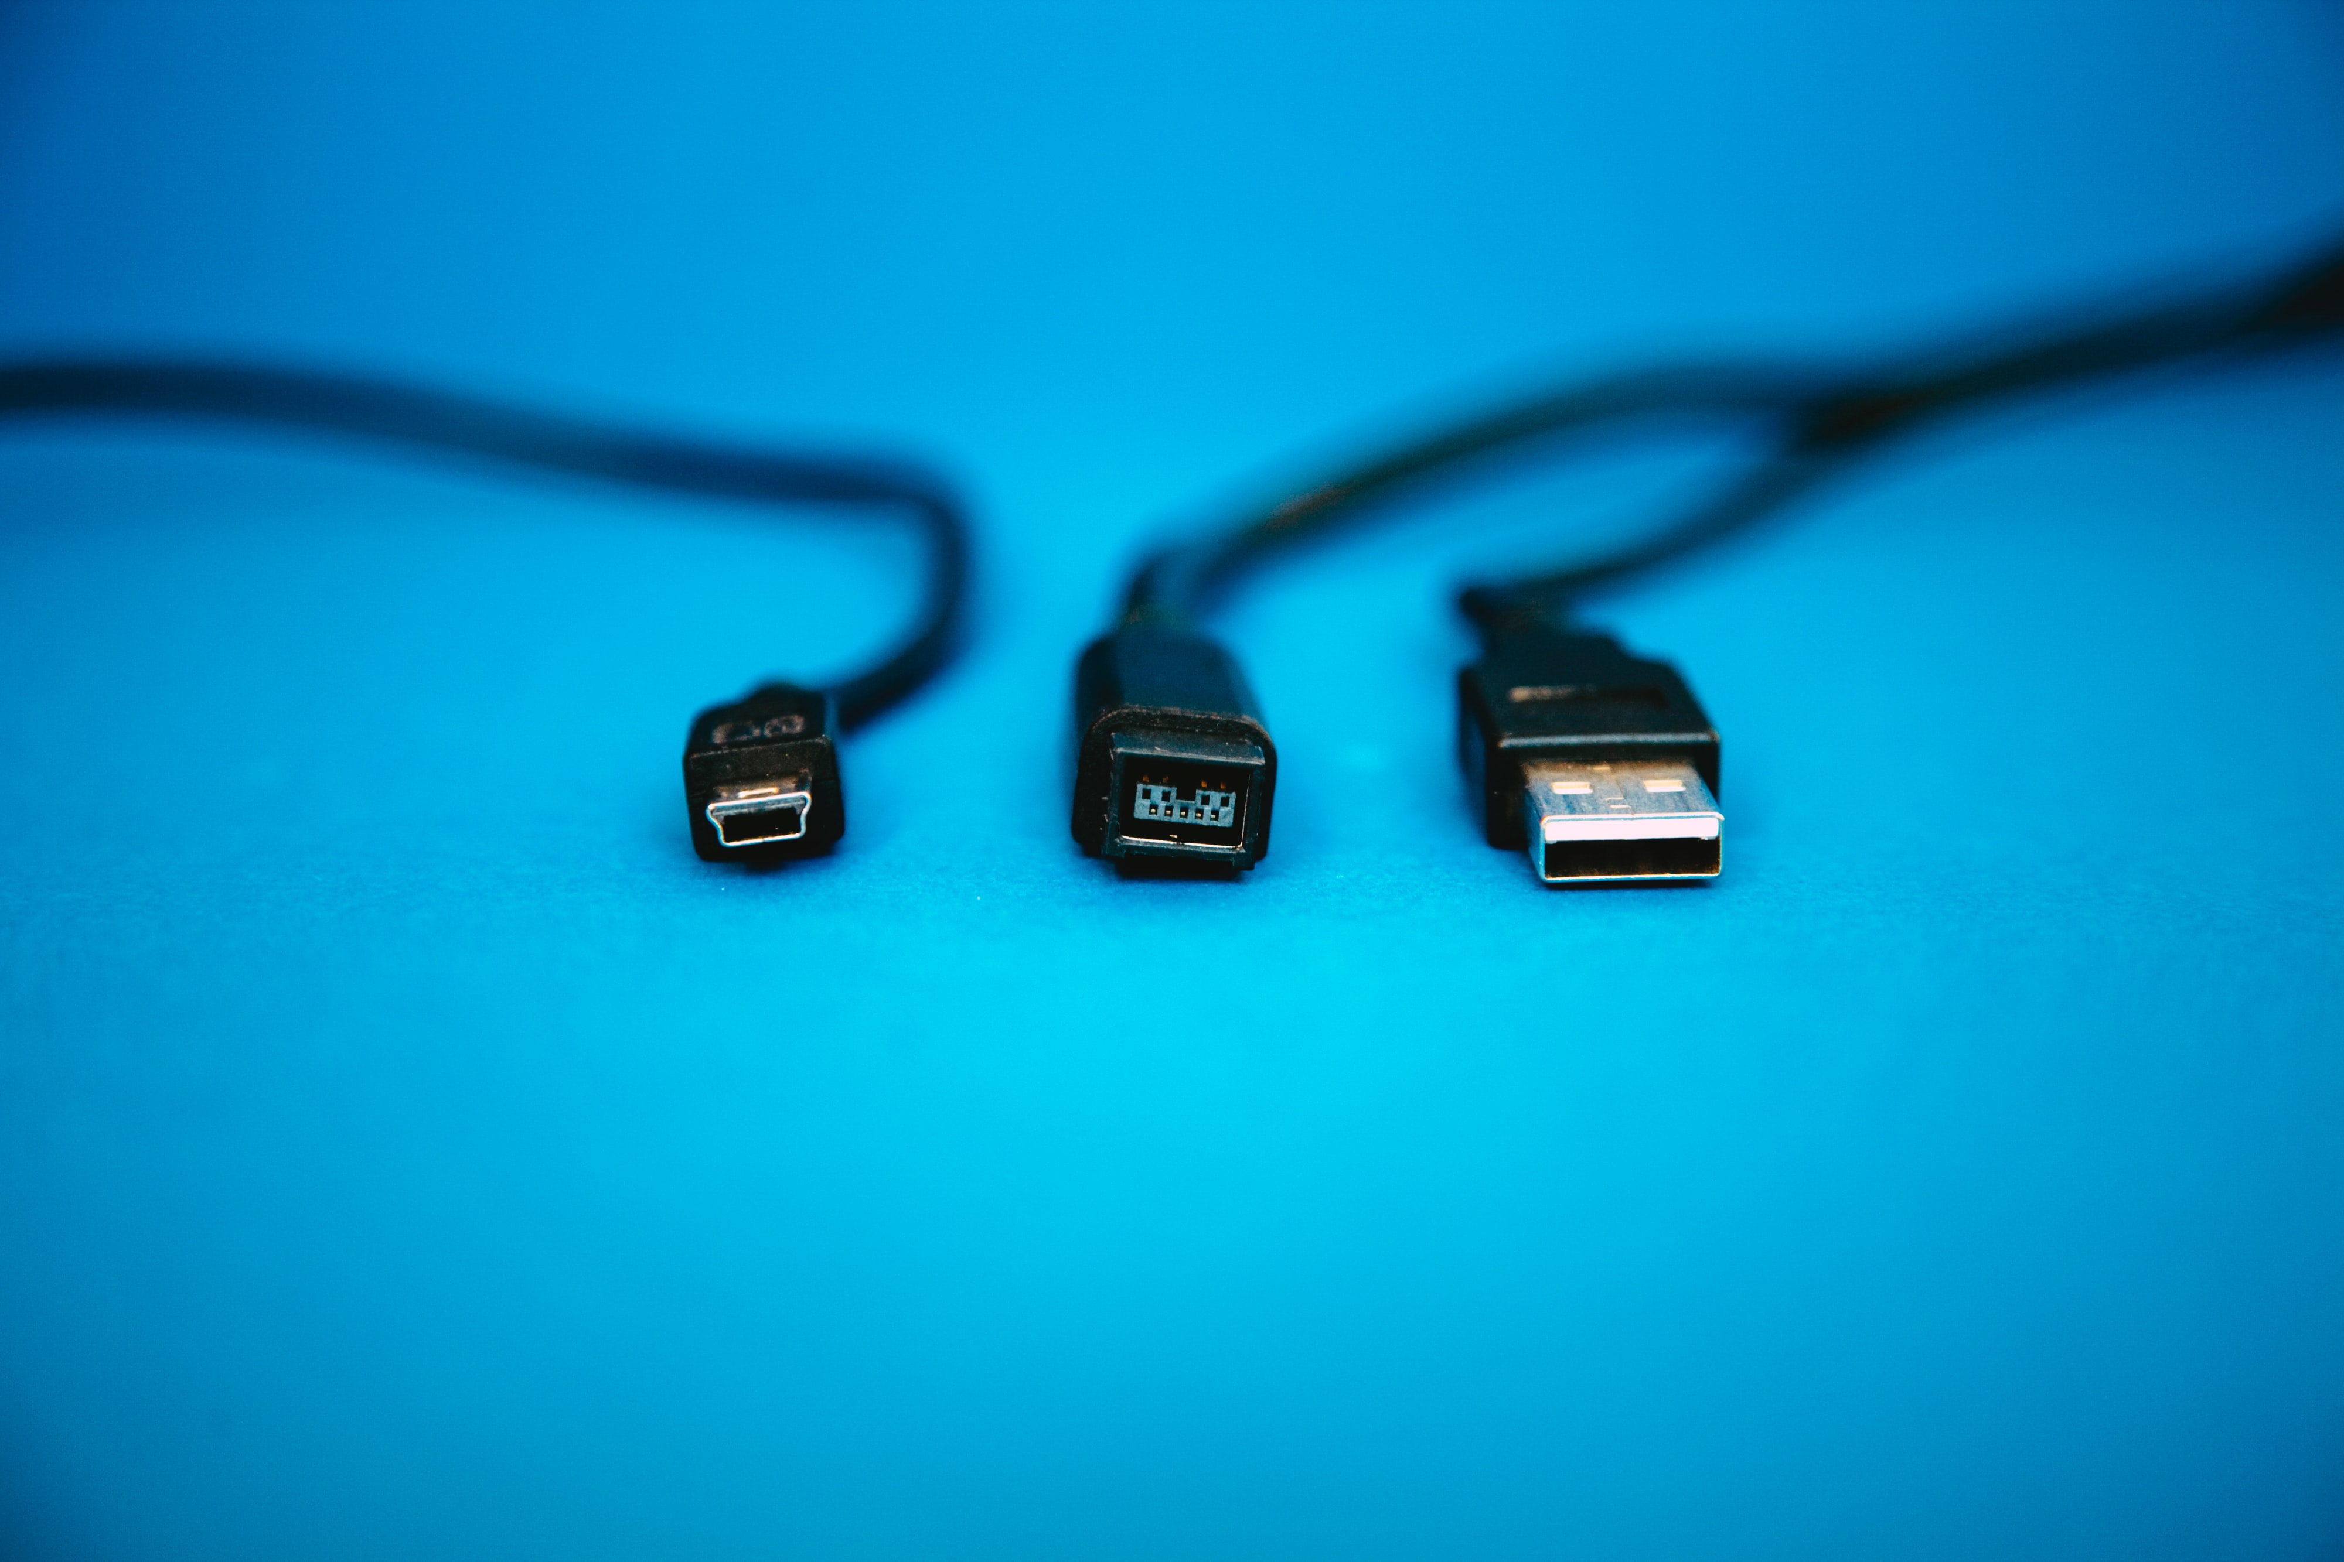
Thank you

